Slide 1
Stability test of 2008 COMPASS data
Yanzhao Wang

Slide 2
The goals of analysis
Selecting out bad runs with abnormal properties
Individual investigation of the bad runs
Postulate of probable cause of the bad runs

Slide 3
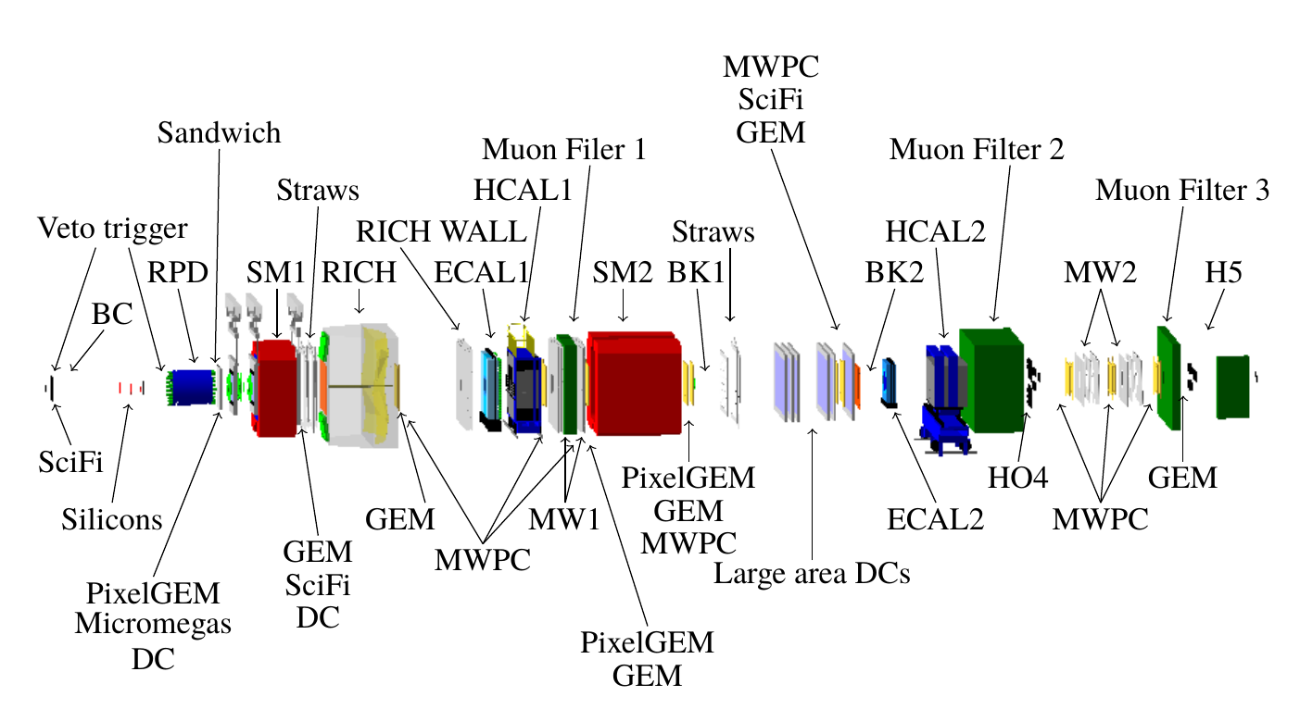
Detector Layout

Slide 4
Datasets and pre-selection:
Datasets info:
Year | 2008
Week | Week 33, 35, 37
Run number | 69595 ~ 70963
Conditions of filtering
A best primary vertex was found
Primary vertex Z-position Z_pv: -200 cm < Z_pv < 160 cm
Exactly three charged tracks, leaving the primary vertex
Charge sum of all three tracks = -1

Slide 5
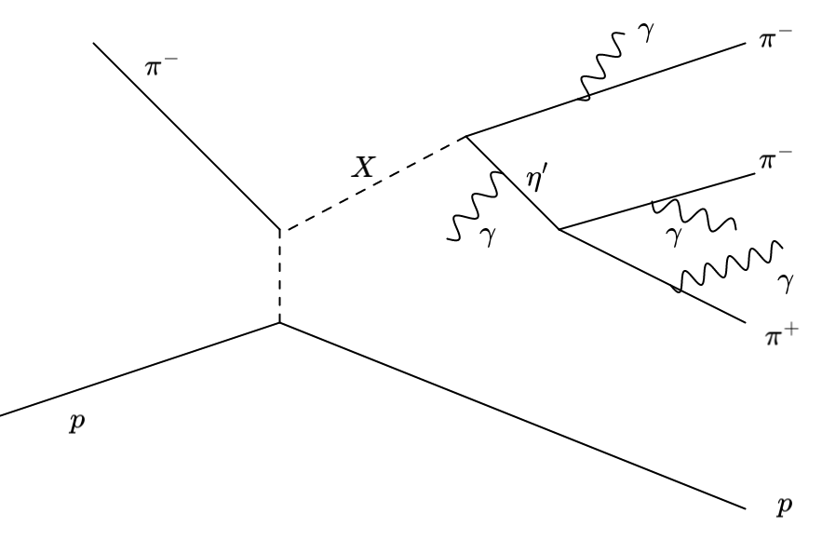
the scheme of possible scattering process

Slide 6
Structure of data storage
Run Number:
... | 69696 | 69697 | 69698 | ... | ... | 70161 | 70162 | 70163 | ...
Spill Number:
... | 3 | 4 | 5 | ... | ... | 188 | 189 | 190 | ...
Events:
... | event 100 | event 101 | event 102 | ... | ... | event 32001 | event 32002 | event 32003 | ...
Particles, tracks, vertices, recoiled protons...

Slide 7
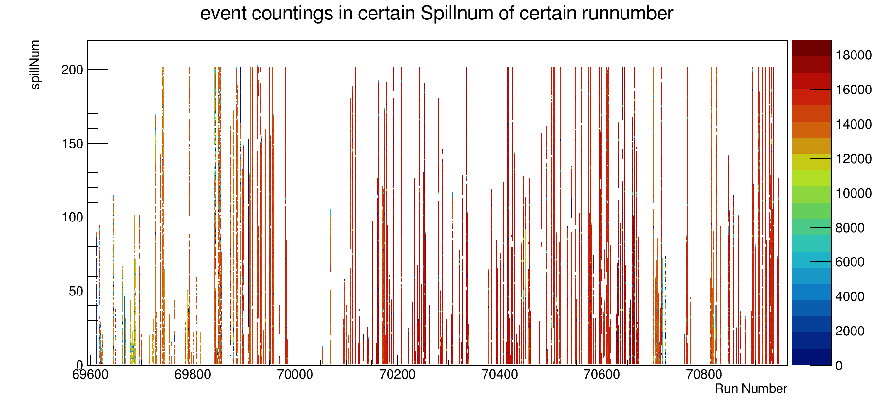
Overlook of event distribution

Slide 8
Parameters investigated
Invariant mass of three pions
The total invariant mass
Photon number from different Calorimeters
The momentum magnitude of beam
Angular distribution of recoiled proton

Slide 9
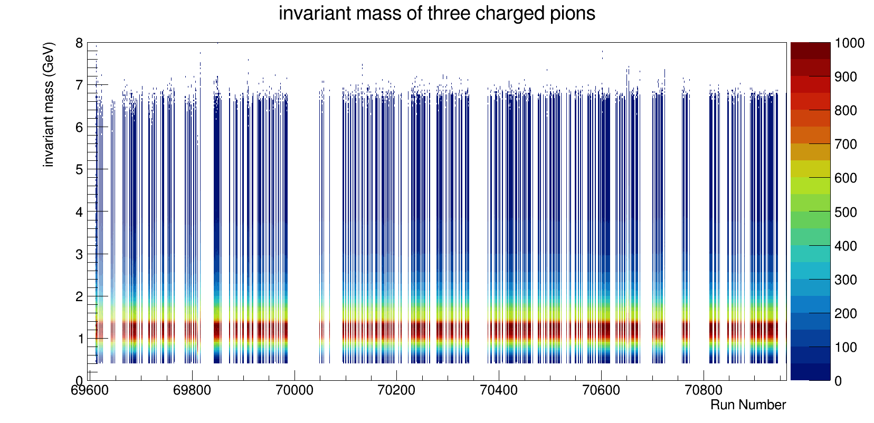
Invariant mass of 3 pions

Slide 10
Invariant mass of 3 pions
Projection of y at x =69853

Slide 11
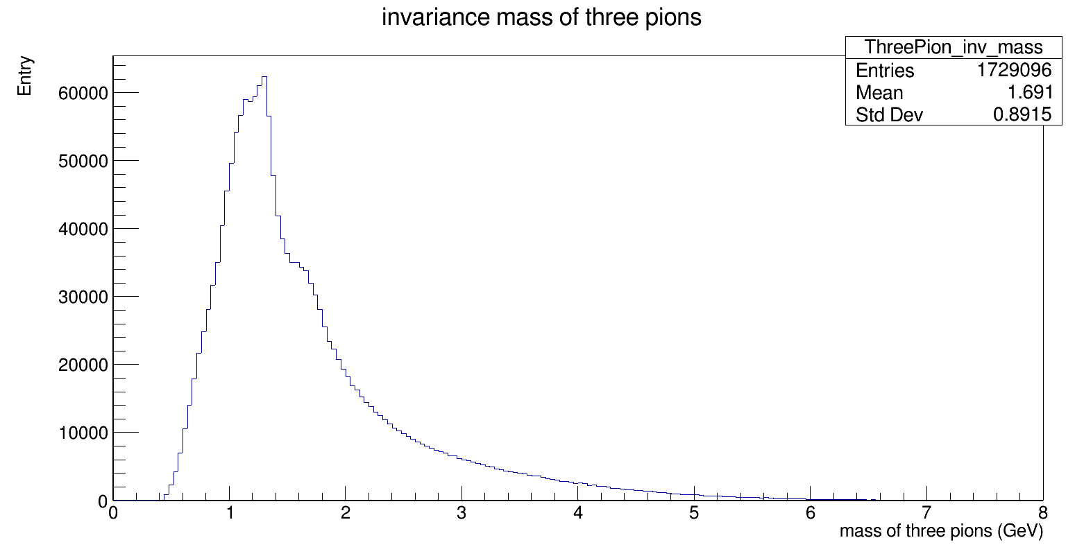
Invariant mass of 3 pions( Run = 69853)

Slide 12
Invariant mass of 3 pions( Run = 69853)
55% of maximum
1.3
1.6

Slide 13
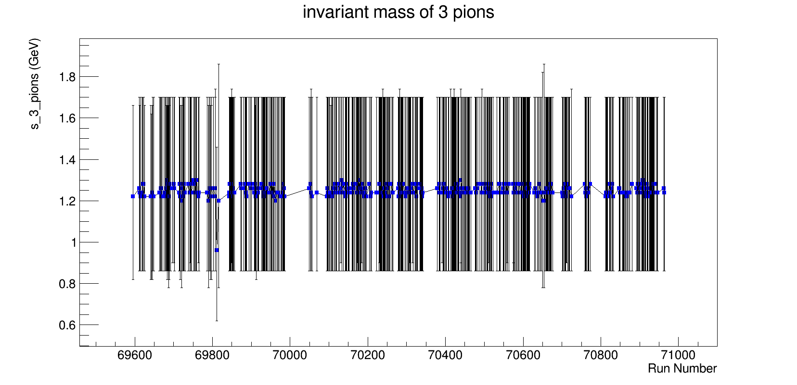

Slide 14
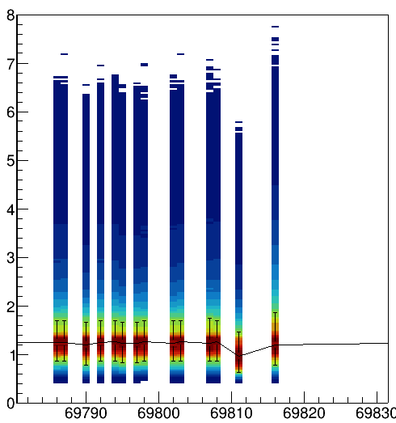

Slide 15
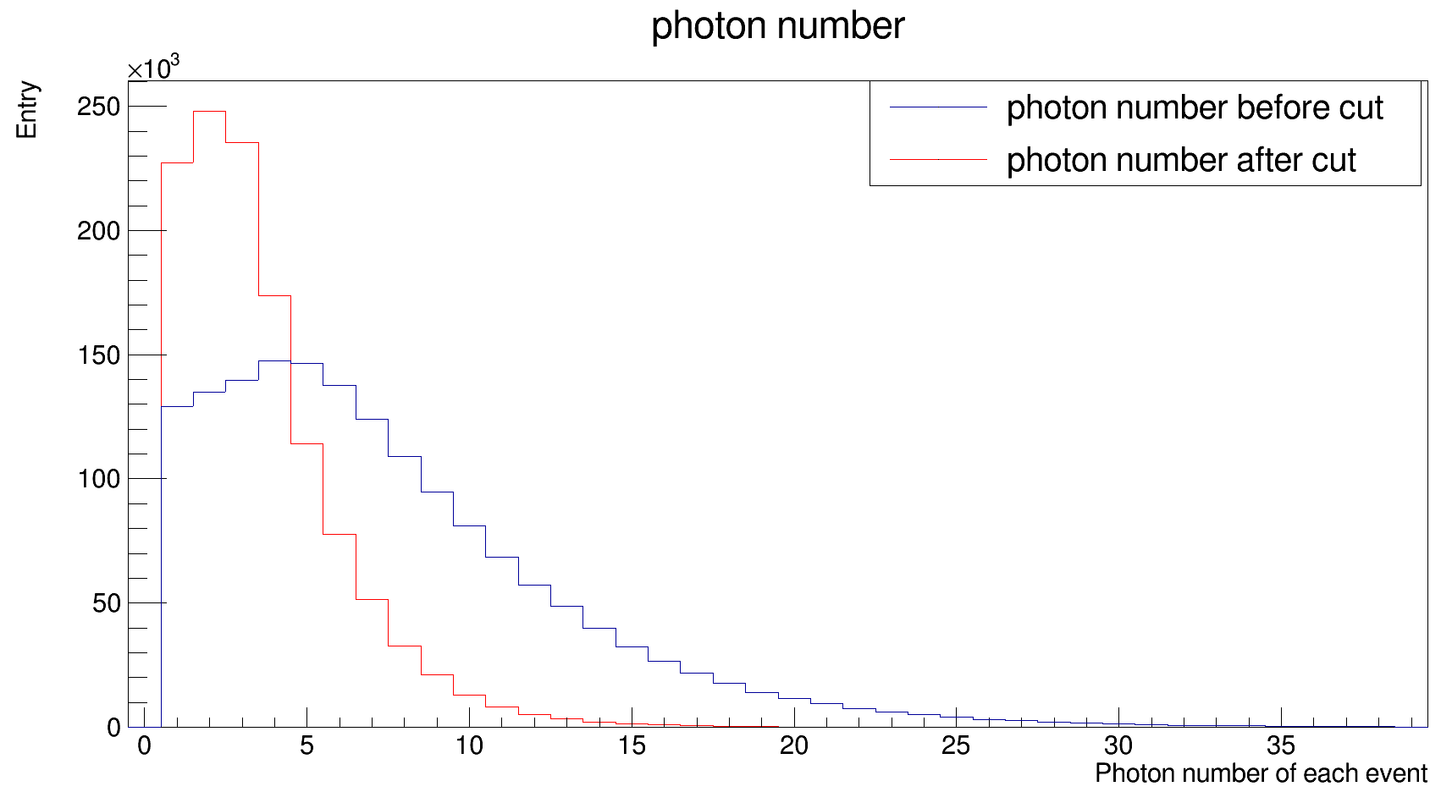
Photon energy cut ( Run = 69853)
Cut condition:
Calorimeter | Energy
ECAL1 | >1 GeV
ECAL2 | >4 GeV

Slide 16
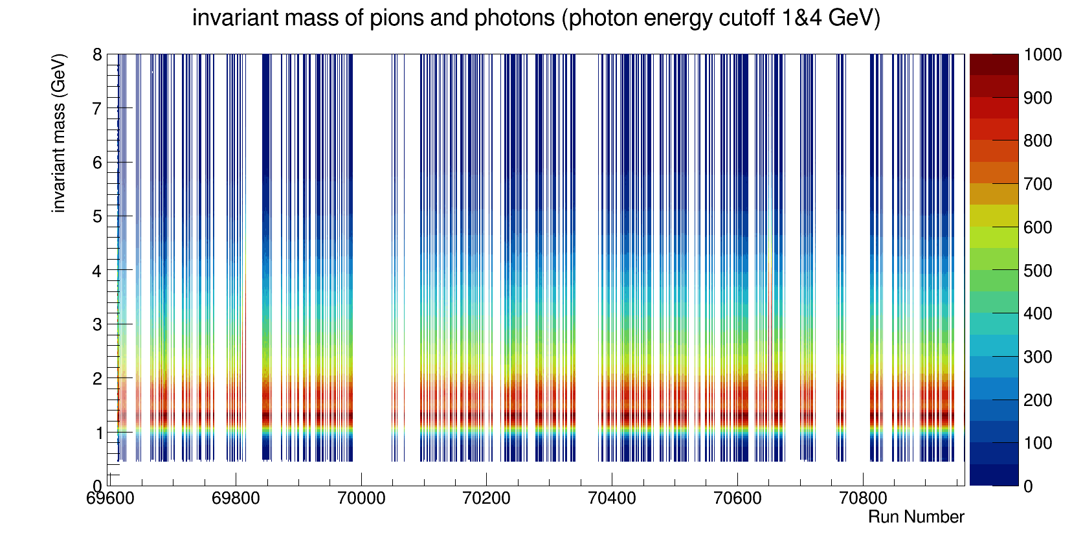
The total invariant mass (normalized)

Slide 17
The total invariant mass (normalized)
Projection of y at x =69853

Slide 18
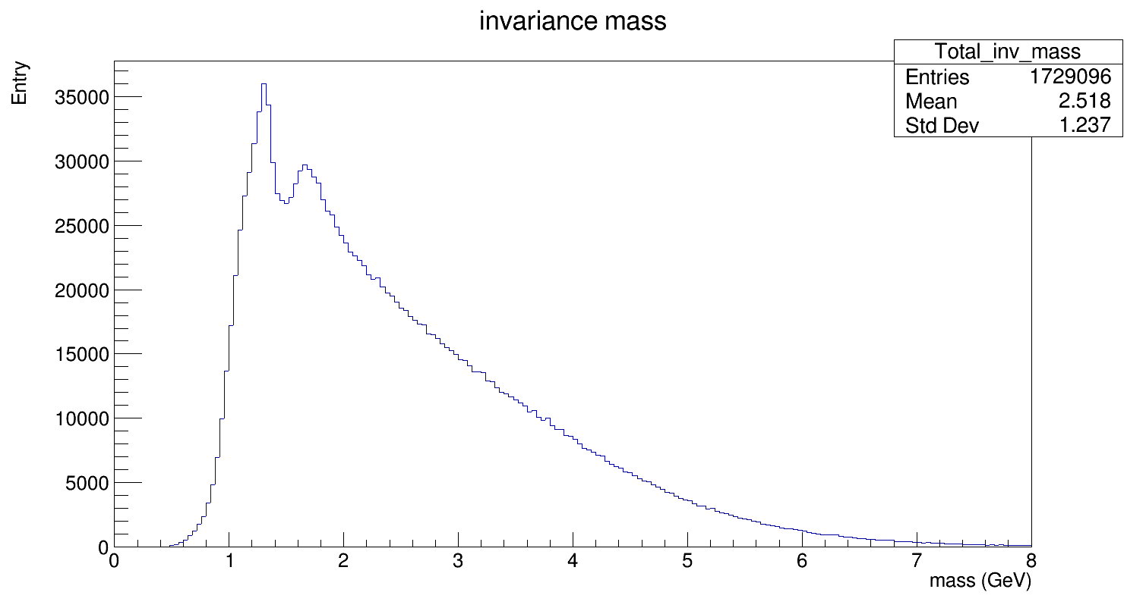
The total invariant mass ( Run = 69853)
1.31
1.66

Slide 19
The total invariant mass (normalized)
Projection of y at x =70650

Slide 20
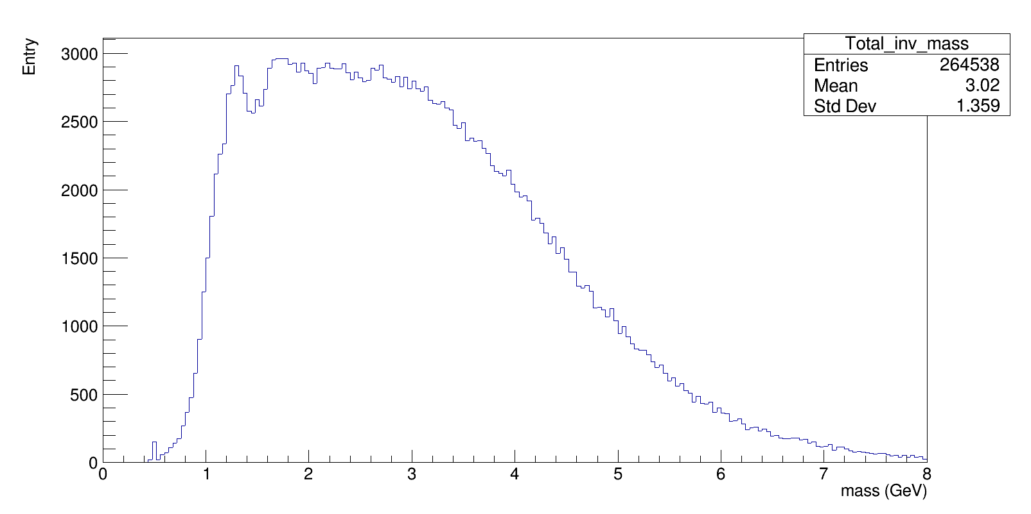
The total invariant mass ( Run = 69853)
FWHM ≈ 3.45 GeV

Slide 21
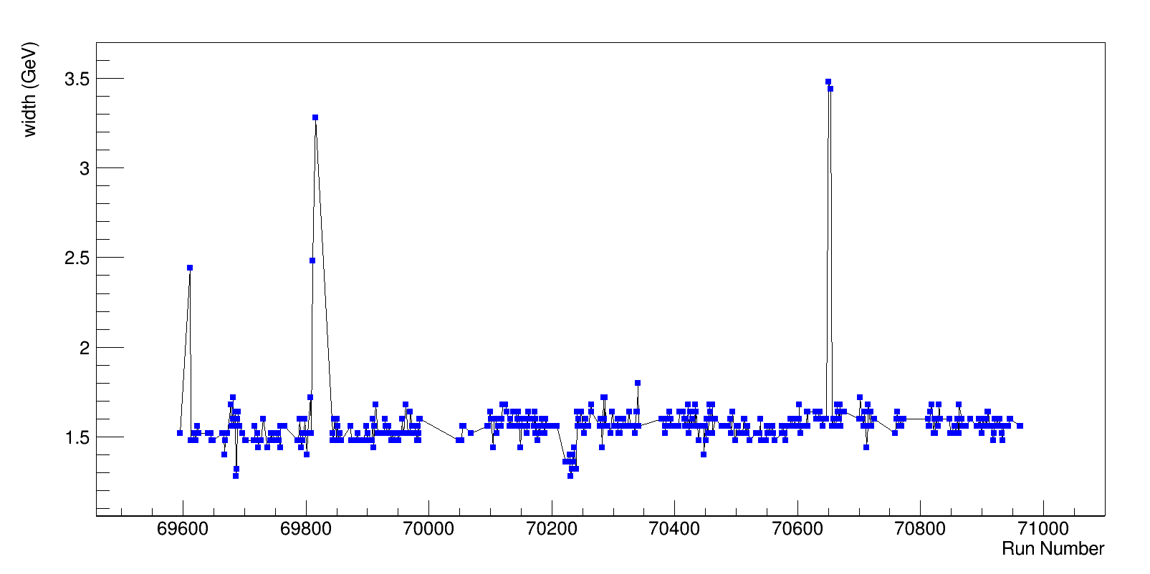
FWHM of total invariant mass

Slide 22
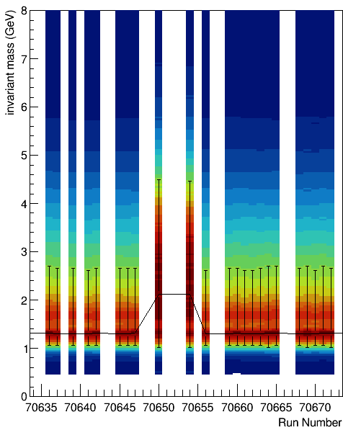
FWHM of total invariant mass

Slide 23
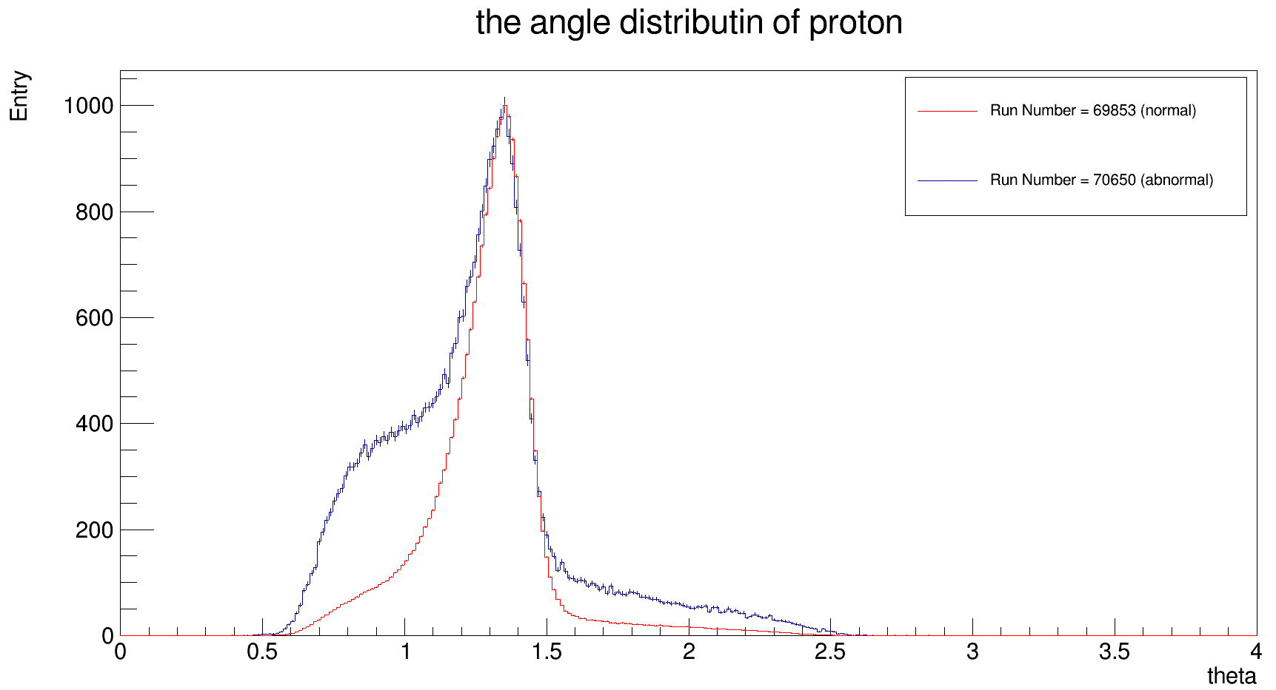
Recoiled Proton angular distribution
Width at 23% of maximum

Slide 24
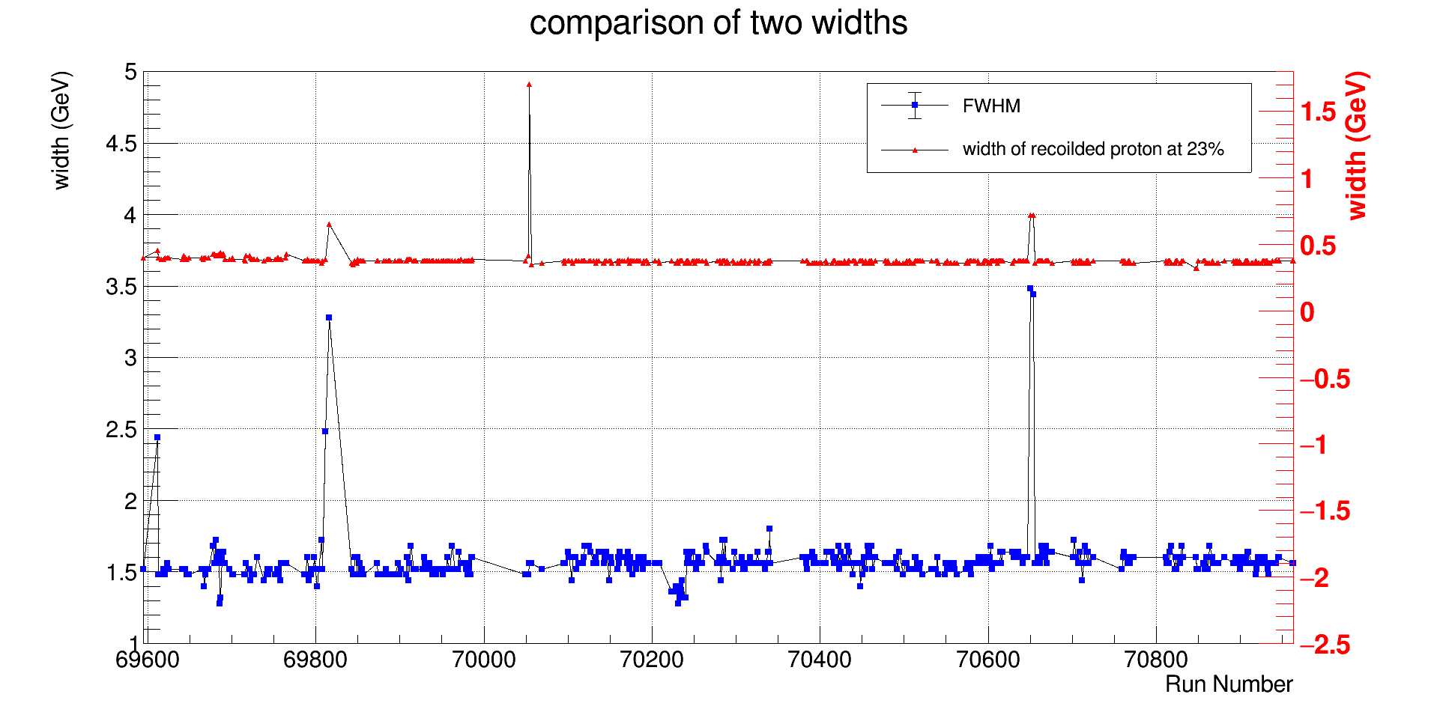
Comparison of widths from invariant mass and angles of recoiled proton

Slide 25
Comparison of widths from invariant mass and angles of recoiled proton
69612
69816
70650 ~ 70654

Slide 26
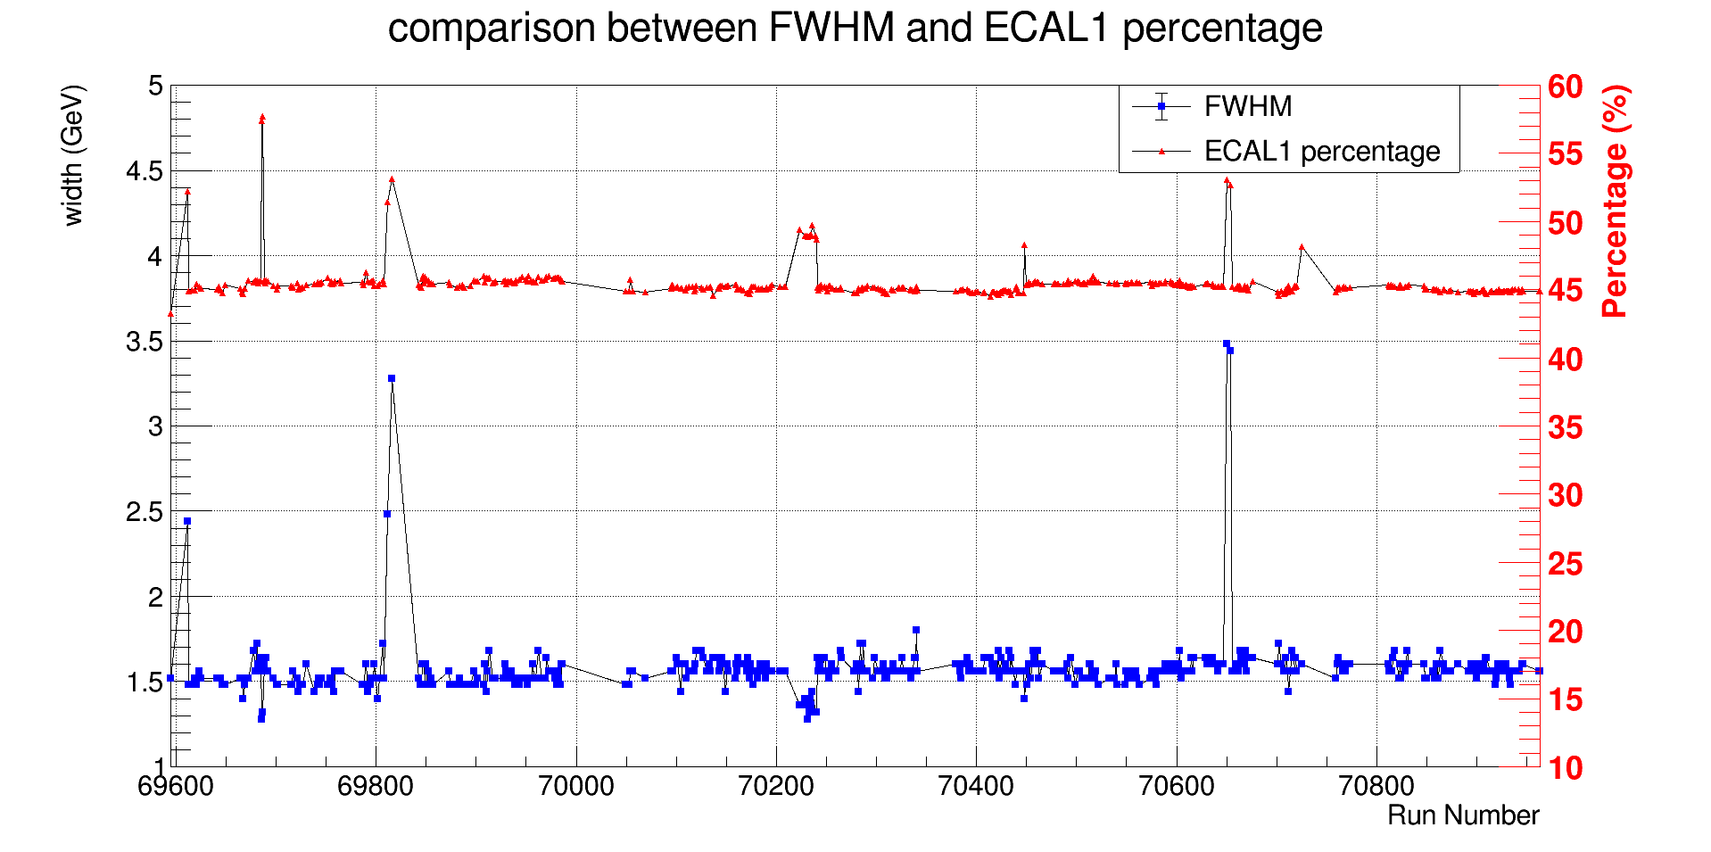
Comparison of ECAL1 percentage and FWHM of invariant mass

Slide 27
Comparison of ECAL1 percentage and FWHM of invariant mass
69696 ~ 69687
70223 ~ 70240
70448

Slide 28
Summary

